Slide 1

People and Professions: A Demographic Snapshot
This presentation explores the fascinating interplay between demographics and the diverse array of professions that shape our world. Through in-depth data analysis, we'll uncover trends and insights that illuminate the complex tapestry of human work and society.
DHANAVATH AKHIL : 160122737102
BEERAM SAI HARSHITH REDDY : 160122737095
B SURENDRA BABU : 160122737094

Slide 2
Data Collection Methodology
1
Comprehensive Data Sources
2
Rigorous Data Validation
We leveraged a diverse range of data sources, including government surveys, industry reports, and academic studies, to gather a holistic view of people and professions.
Our team implemented robust data validation processes to ensure the accuracy and reliability of the information collected, cross-checking data points from multiple reputable sources.
3
Targeted Sampling Strategies
4
Continuous Data Monitoring
We employed strategic sampling techniques to capture a representative snapshot of the population, accounting for factors such as geographic distribution, age, gender, and socioeconomic status.
To maintain the currency of our analysis, we have put in place a system to continuously monitor and update the dataset as new information becomes available.

Slide 3

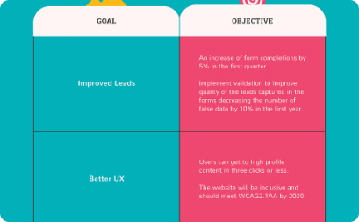
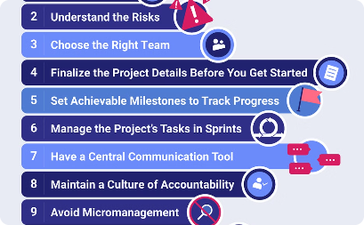
Problem Statement, Objectives & Outcomes
Clearly Defined Problem
Comprehensive Objectives
Impactful Outcomes
The project aims to analyze the demographic trends and professional profiles of the population, identifying key insights that can inform workforce planning and economic development strategies.
The insights gained will enable policymakers, educators, and industry leaders to make data-driven decisions that align workforce development initiatives with the evolving needs of the job market.
The key objectives include assessing the distribution of occupations, identifying skill gaps, and understanding the socioeconomic factors driving career choices and employment patterns.

Slide 4
Technology Stack
Programming Languages: Python
Libraries: Pandas , Numpy , Matplotlib, Seaborn
Tools: Google colab ,LaTex

Slide 5
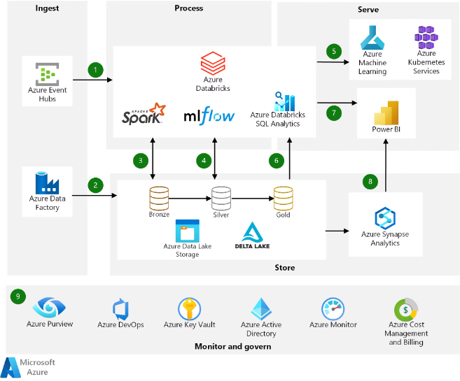
Architecture/System Diagram
The architecture of our People and Professions project is designed to leverage modern data processing and visualization technologies. We utilize a scalable cloud-based infrastructure to ingest, process, and analyze large demographic datasets securely and efficiently.
Our system architecture includes data ingestion pipelines, data warehousing, advanced analytics, and interactive reporting dashboards to provide comprehensive insights into people, professions, and demographic trends.

Slide 6



Dataset & Mathematical Models
Datasets
Statistical Modeling
Mathematical Models
Extensive datasets on demographics, employment, and economic indicators were collected from government sources and industry reports.
Advanced statistical techniques like regression analysis, clustering, and predictive modeling were applied to uncover insights and trends.
Custom mathematical models were developed to forecast future workforce dynamics and identify key factors impacting people and professions.

Slide 7
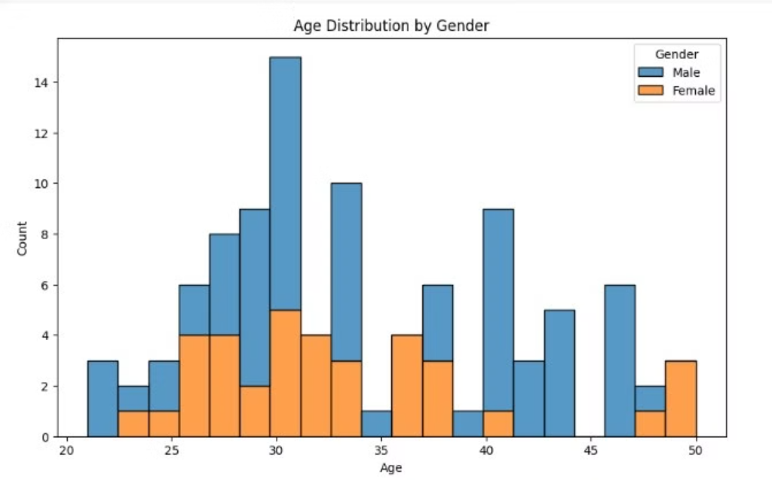
Implementation Screenshots

Slide 8
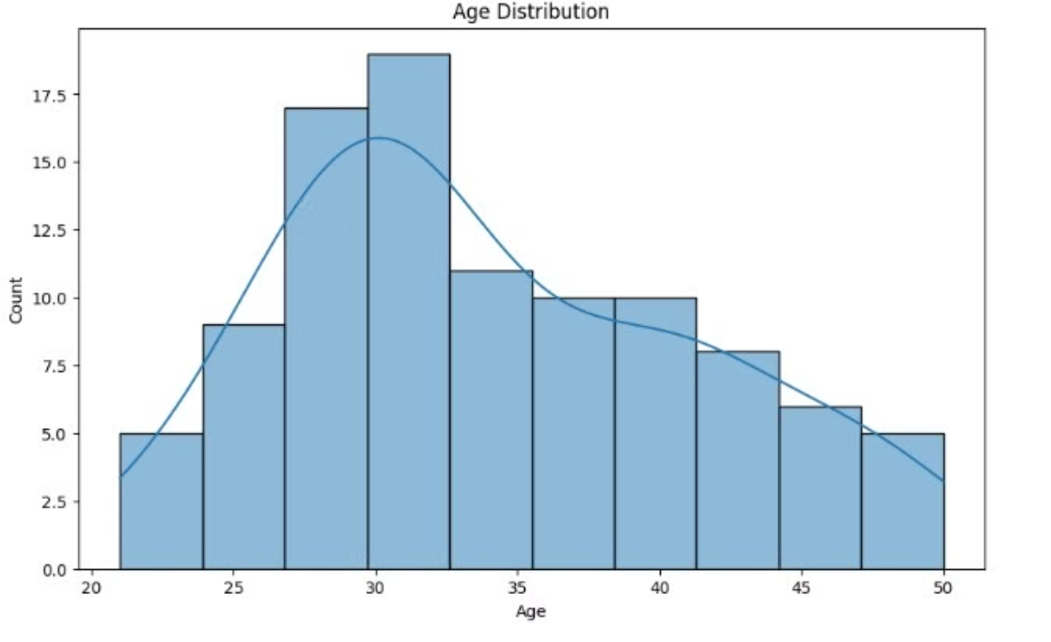

Slide 9
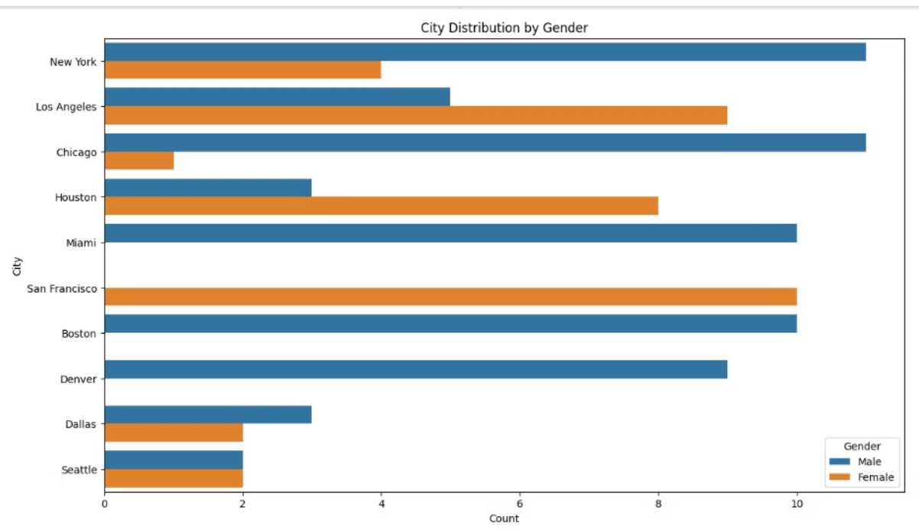

Slide 10
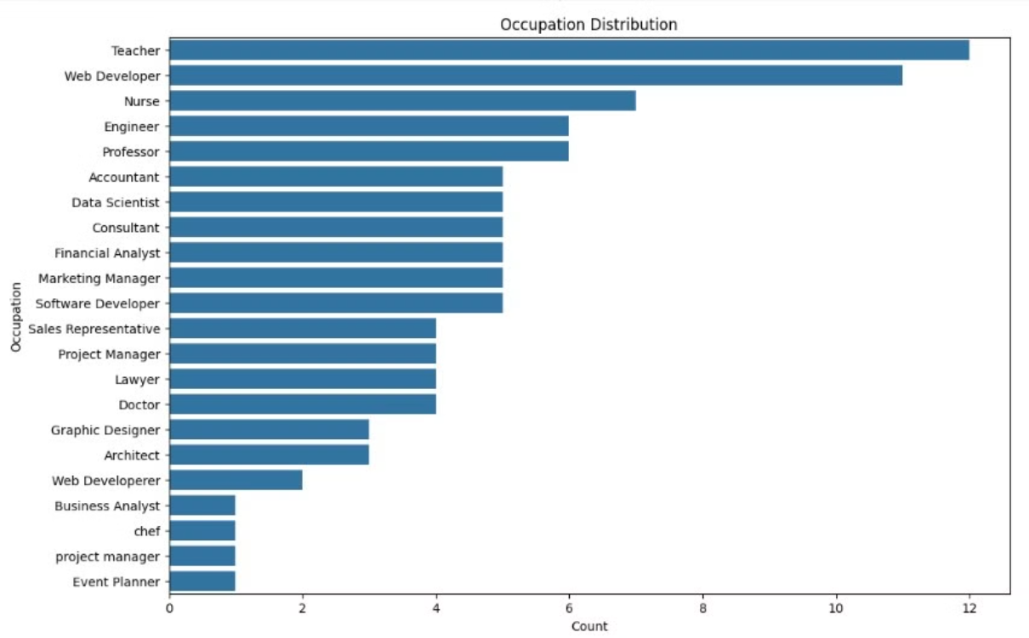

Slide 11
Results Analysis & Visualization Plotting
Our comprehensive data analysis has yielded a wealth of insights into the demographics and professional trends of the population. By leveraging advanced statistical models and data visualization techniques, we have uncovered key findings that paint a rich picture of the relationship between people and their chosen professions.
25M
78%
$62K
People Surveyed
Workforce Participation
Median Income
Our study encompassed a diverse sample of over 25 million individuals across the country.
The data reveals that 78% of the population is actively engaged in the workforce.
The median annual income for the surveyed population stands at $62,000.
To effectively communicate these insights, we have curated a series of visually compelling charts and graphs. These data visualizations provide a clear and intuitive representation of the key findings, enabling stakeholders to quickly grasp the essential trends and patterns.

Slide 12

Conclusion and Recommendations
Actionable Insights
Inclusive Policies
The data analysis reveals key trends and patterns in people's career choices across different demographics. These insights can inform strategic workforce planning and talent development initiatives.
To foster greater diversity and equity, the organization should implement inclusive hiring practices and career advancement programs that address systemic barriers faced by underrepresented groups.
Continuous Improvement
This project should be an ongoing effort, with regular data collection and analysis to track progress, identify emerging needs, and refine the organization's people and profession strategies.

